Slide 1
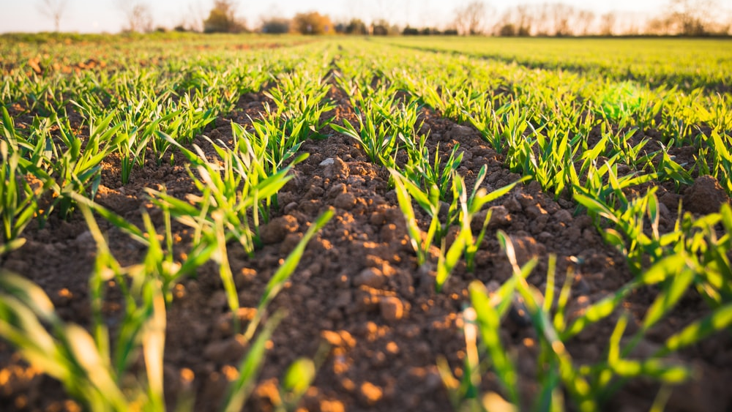
PYTHON PROJECT
TOPIC-
AGRICULTURAL CROP OPTIMISATION
MADE BY- AKSHITA JAIN

Slide 2
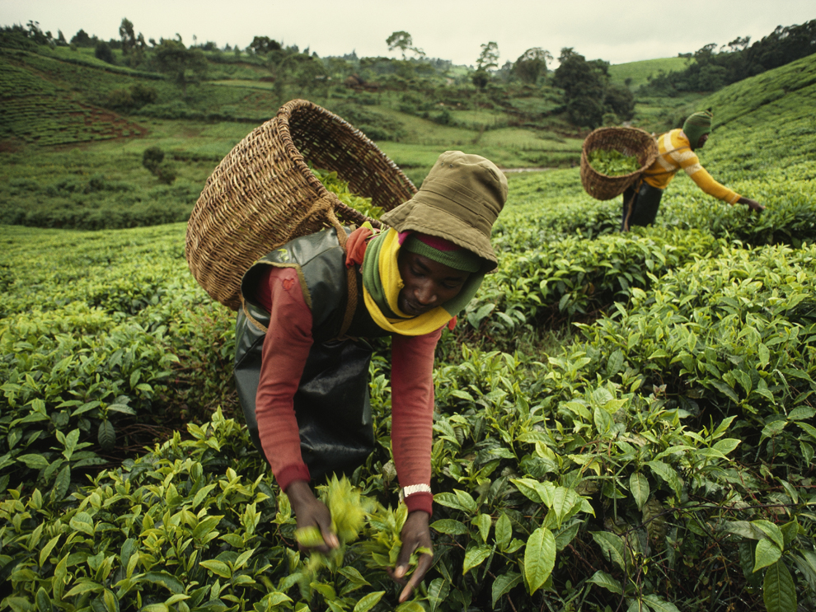
INTRODUCTION
Agriculture is vital for the development of the world. Farmers will always need information to refer to, most especially when growing crops that are not common in their land or culture . There is, therefore, a need for a system that allows farmers access to relevant information
Crop prediction technology is used to predict the suitable crop by sensing the various parameters of soil( such as pH, nitrogen, phosphate, potassium), and also parameter related to atmosphere( such as sunshine hours, temperature and rainfall)
These weather conditions have a direct affect on crop yield
Hence these parameters are considered as the input for the proposed system and based on the manipulations with these inputs, the desired outputs must be produced

Slide 3
STEPS REQUIRED
Dataset from- https://www.kaggle.com/datasets/atharvaingle/crop-recommendation-dataset
collecting the data
Importing libraries
Reading the dataset
Cleaning Data
Data visualization
Splitting the data into train and test
Training the model with different classifiers
Identifying the best classifier
Prediction of crops

Slide 4
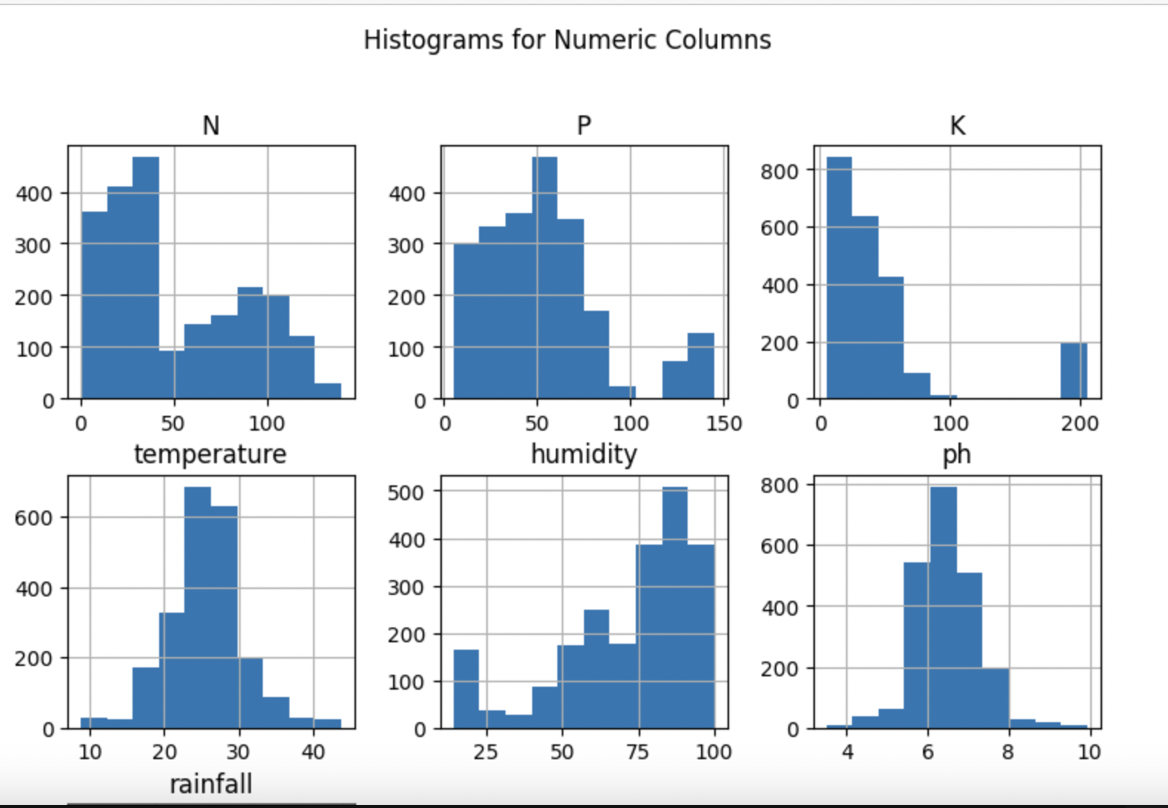
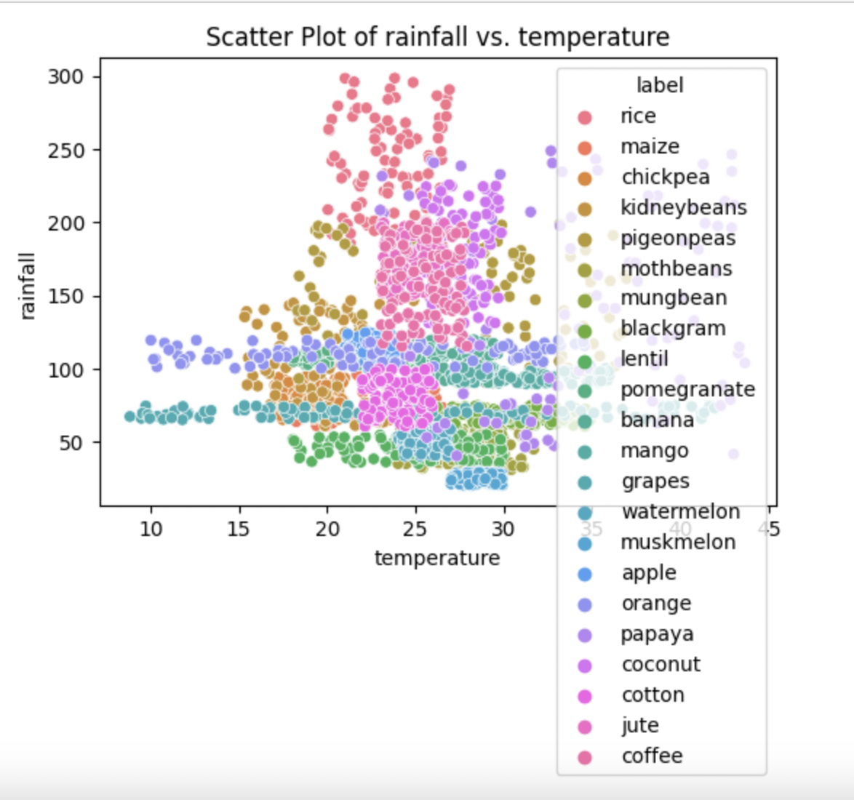
DATA VISUALIZATION
We have created a grid of histograms, each depicting the frequency distribution of a particular numeric column with 10 bins. This visualization helps to understand the spread, skewness, and central tendency of the numeric data.
We have created a scatter plot to illustrate the relationship between two variables, temperature and rainfall, using the Seaborn library. This scatter plot allows us to visualize correlations or patterns between temperature and rainfall and assess the influence of the 'label' variable on these relationships.

Slide 5
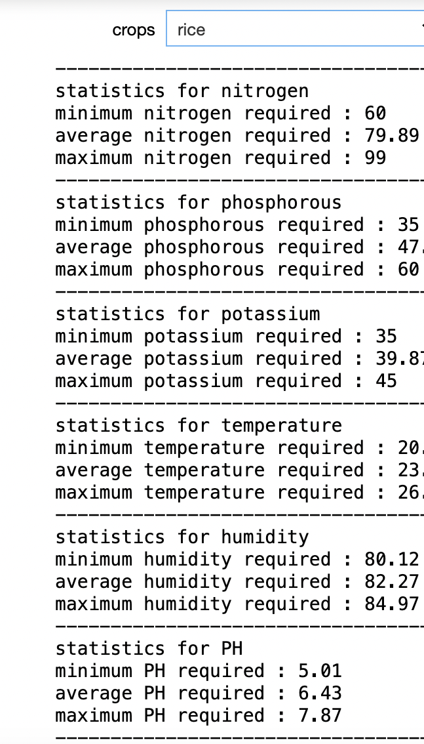
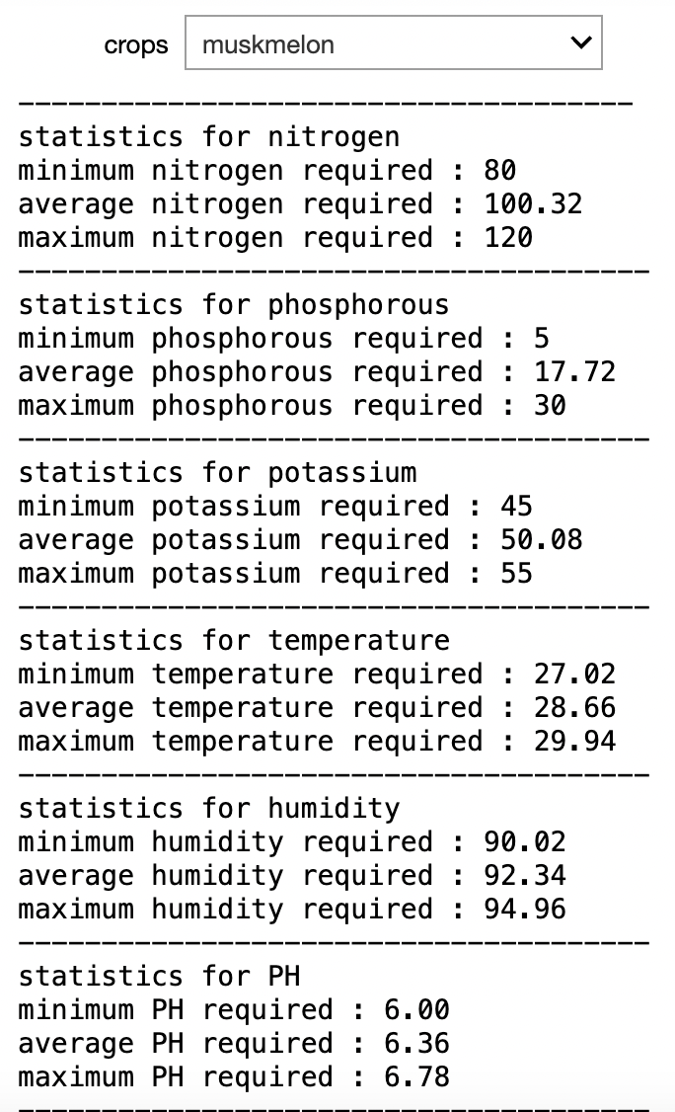
For each attribute, the code calculates and displays the following statistics: Minimum value: The lowest recorded value in the dataset for the selected crop type. Average value: The mean or average of the data. Maximum value: The highest recorded value for the crop.

Slide 6
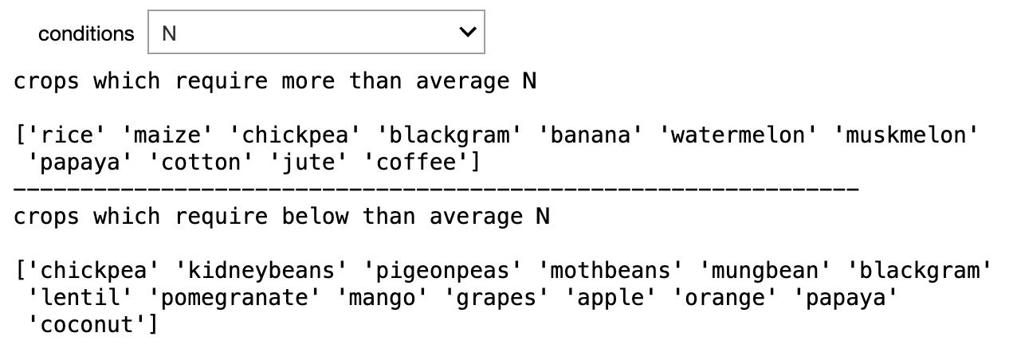
We have created quick way to compare crops based on a specific condition's average, enabling users to identify which crops have higher or lower requirements. It can be helpful for agricultural planning, resource allocation, and understanding crop distribution in relation to various environmental factors.
Upon selecting a condition, the function does the following:
Crops Requiring More than Average:
It finds all crops that have a value greater than the mean for the selected condition.
The unique crop labels that meet this criterion are printed.
Crops Requiring Less than or Equal to the Average:
Similarly, it identifies crops with values less than or equal to the mean for the selected condition.
The unique crop labels for this category are also printed.

Slide 7
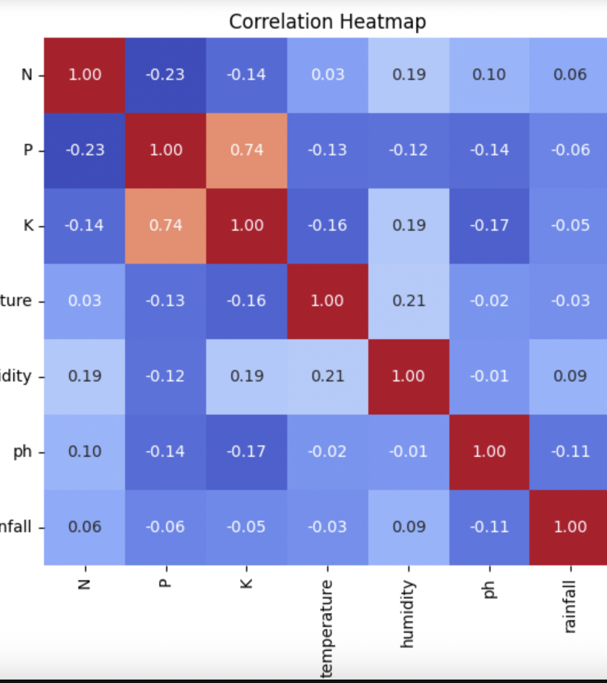
CORRELATION
The final plot visually represents the correlations between variables in the dataset, allowing us to quickly identify strong positive or negative relationships and weak correlations.
-Results
As we can see K and P are highly correlated
Temperature and N are not that much correlated

Slide 8
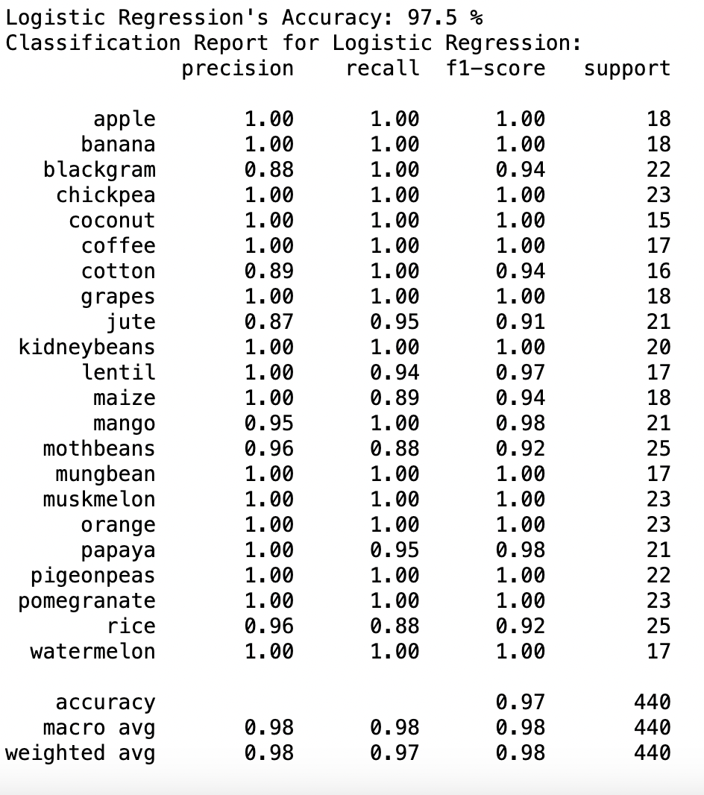
MODEL BUILDING 1. Logistic Regresssion
In logistic regression, the relationship between the independent variables (K, P, rainfall, temperature , etc.) and the dependent variable (Crops) is modeled using the logistic function.
The fit method is used to train the model using the x_train (K,P, temeparture, rainfall) and y_train (crop). After training, the model is used to predict the outcomes for the x_test data set.
Model Accuracy: The code calculates the accuracy of the model. The accuracy is a measure of the proportion of correct predictions out of all predictions. Th report helps to understand the model's effectiveness and identify potential areas for improvement.

Slide 9
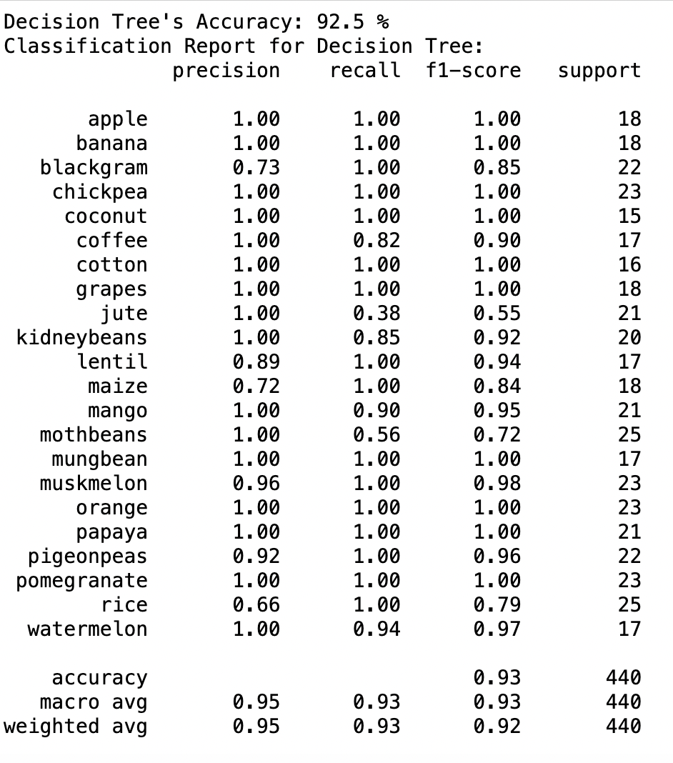
2. Decision Tree
A decision tree is a supervised learning algorithm used for both classification and regression tasks. It is a tree-like structure where each internal node represents a test on an attribute (feature), each branch represents an outcome of the test, and each leaf node represents a class label (for classification) or a continuous value (for regression).
The fit method trains the decision tree using the x_train (K, P, Tempearture, Rainfall) and y_train (Crop)..
Predicting Outcomes: After training, the model predicts the outcomes for the x_test data set.
Model Accuracy: The model calculates the accuracy of the decision tree model by comparing the predicted outcomes (y_pred_tree) with the actual outcomes (y_test).

Slide 10
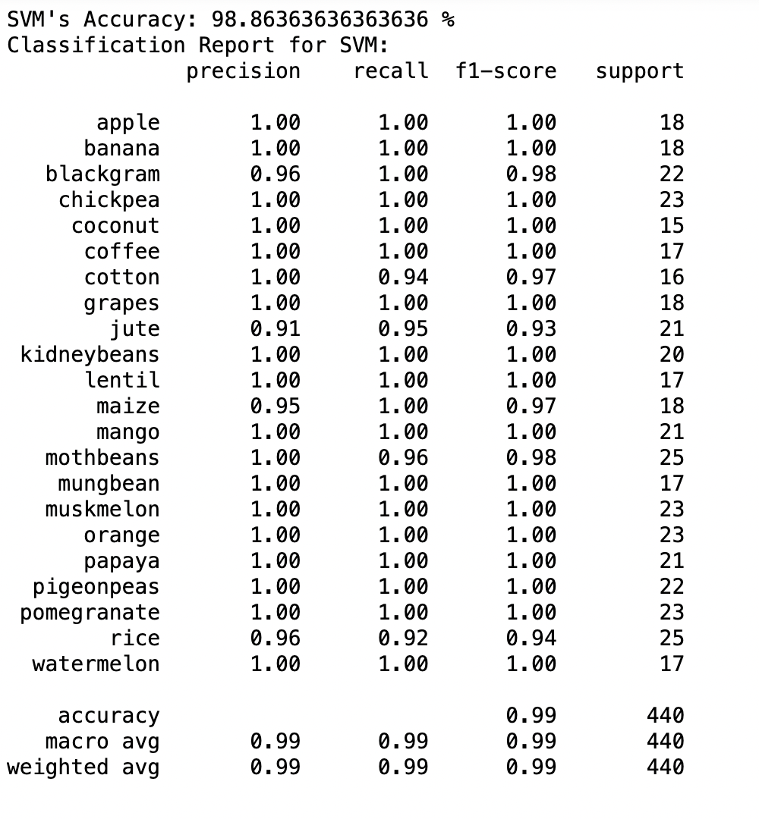
3. SVM(Support Vector Machine)
Support Vector Machines (SVM) are a class of supervised machine learning algorithms used for classification and regression tasks. The primary concept behind SVM is to find the optimal hyperplane that best separates different classes in the feature space.
This model creates an instance of the SVC class with a linear kernel and a regularization parameter C=1.
Training the SVM: The fit method is used to train the SVM classifier with the x_train (K, P, Temeparure, rainfall) and y_train (crops).
Making Predictions: After training, the model uses the trained SVM to predict the outcomes for the x_test data set. The predictions are stored in y_pred_svm.
Model Accuracy: The code calculates the accuracy of the SVM classifier by comparing the predicted outcomes (y_pred_svm) with the actual outcomes (y_test).

Slide 11
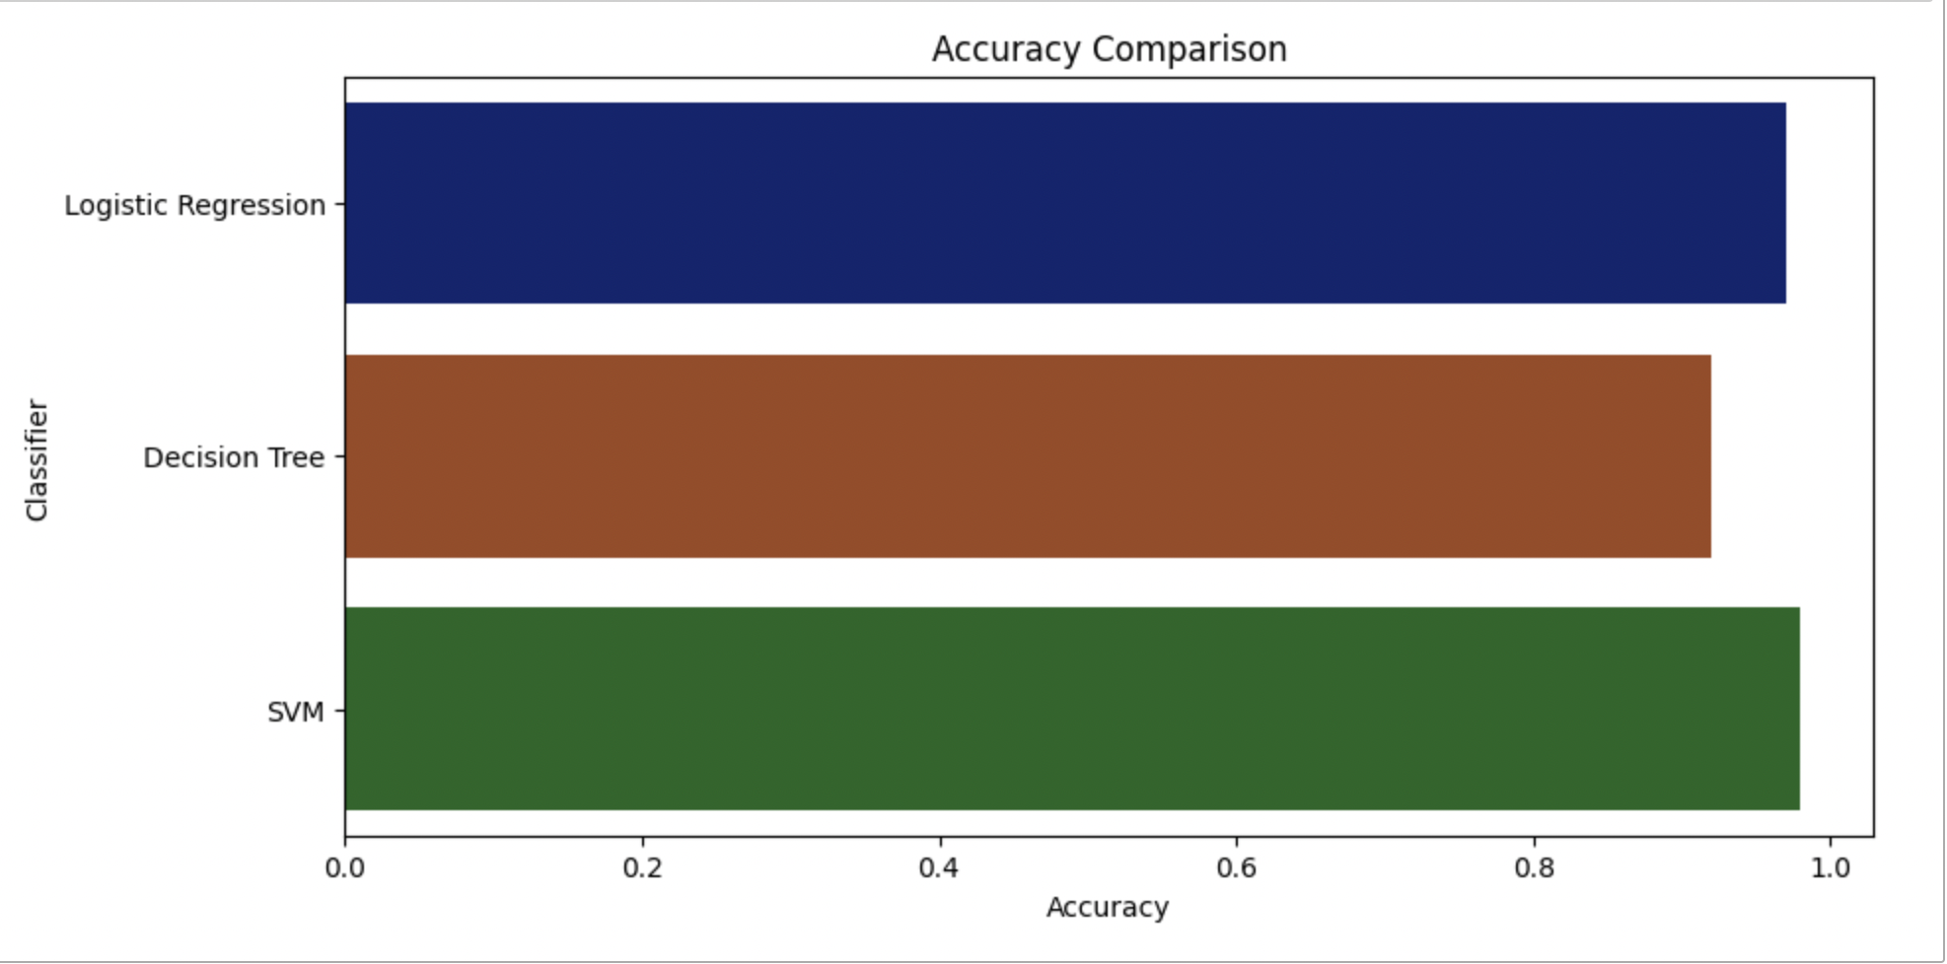
BEST MODEL
As we can see SVM is giving us the best accuracy of 98%

Slide 12
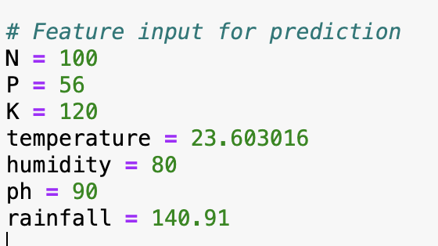
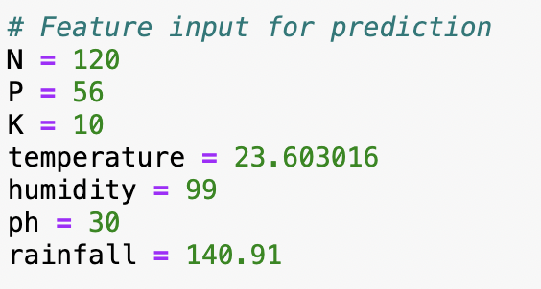
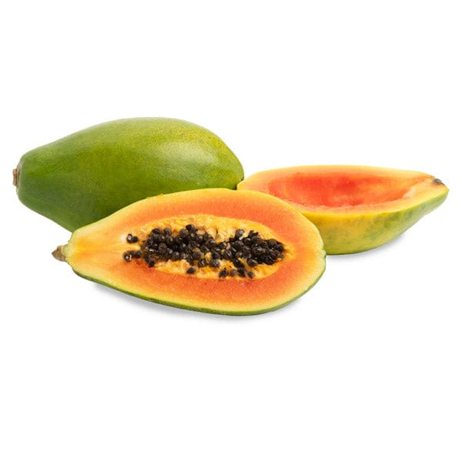
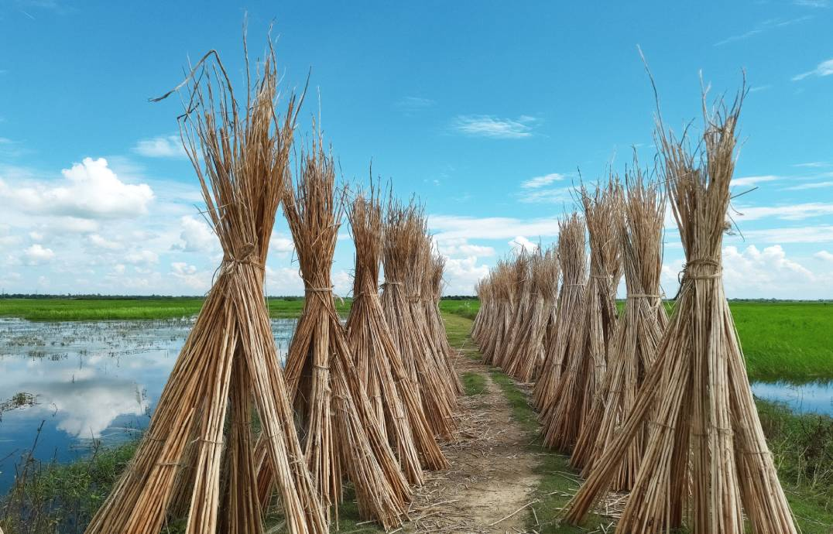
Prediction of Crops
This illustrates how to make predictions with a trained Support Vector Machine (SVM) model using specific feature inputs related to climatic conditions and nutrient content like Rainfall, temperature, Nitrogen, Phosphorous, etc. and suggesting the best crops based on these inputs.

Slide 13
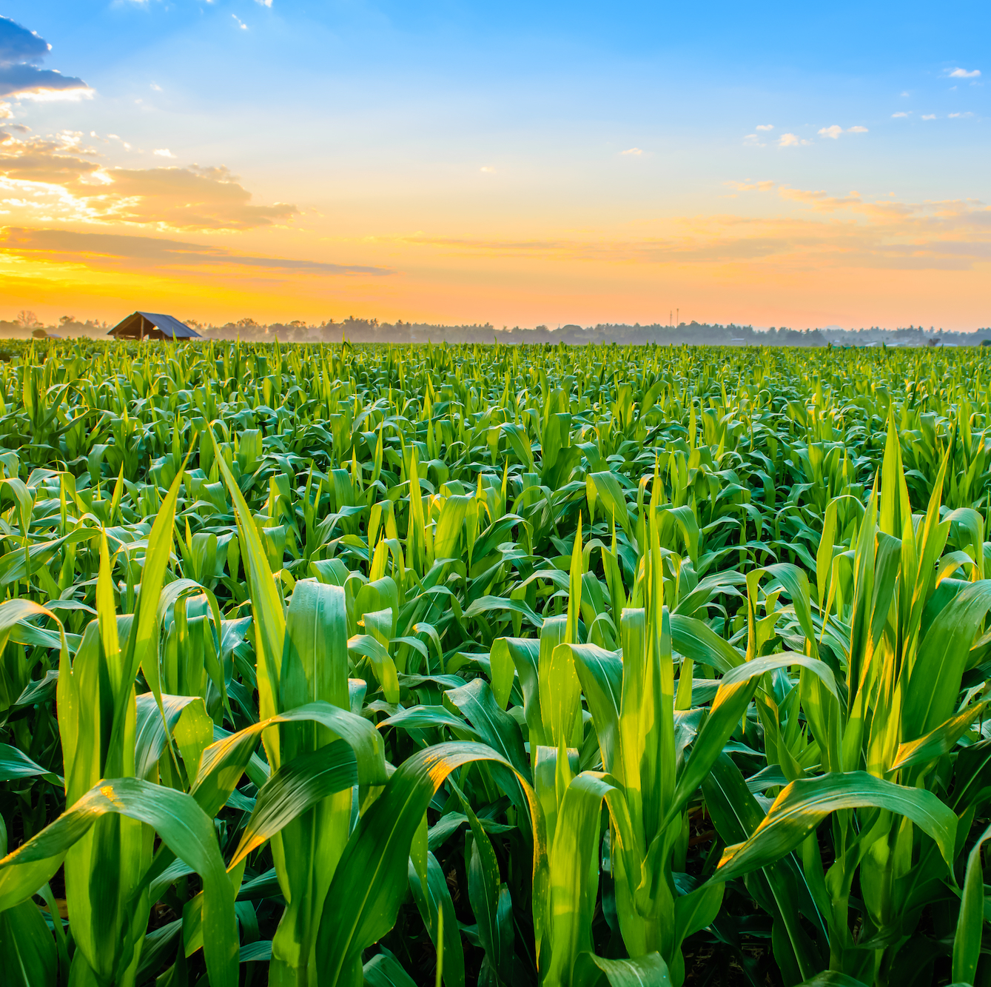
RESULT ANALYSIS
From the results , it is clearly identified that the proposed system functions properly on the input data, manipulates it and provides the desirable output.
We have concluded that various factors affect the crop yield like pH level, temperature, rainfall, potassium, nitrogen, phosphorous , etc.
We have also concluded other things like crops that are summers based and the crops that are winter based.

Slide 14


